Slide 1

Topic: Probability
EQ: What are some characteristics of probability and when do we see it in our lives?
When I say ‘Go’, you have 2 minutes to write down everything you know about probability.
What words do we use to describe it?
What is probability?
When do we use it in our daily lives?
THINK – PAIR - SHARE
Now share with a partner and then we’ll discuss as a class

Slide 2

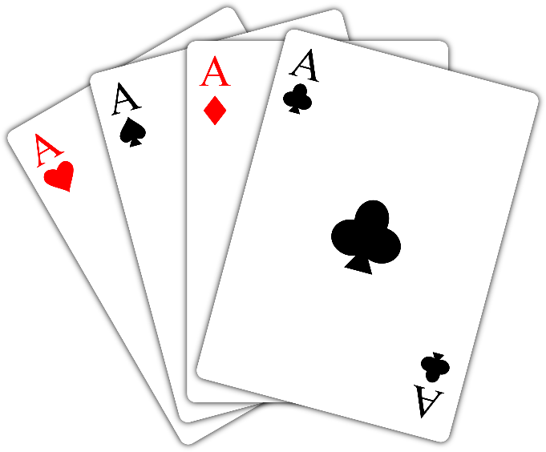

So, what are some things that we identified as involving probability?
Gambling
Insurance
Weather Prediction
Coin tosses – sporting events

Slide 3
Topic: Probability
EQ: What are some characteristics of probability and when do we see it in our daily life?

Slide 4
Starter
Video - The Monty Hall Problem
https://www.youtube.com/watch?v=mhlc7peGlGg

Slide 5

Topic: Probability
EQ: What are some characteristics of probability and when do we see it in our lives?
What is probability?
Probability is the word we mathematicians use to describe chances. It can be described using words, fractions, decimals or percentages.
How is probability measured?
One way Probability is measured is using a probability scale, starting at 0 (impossible) and ending at 1 (certain).

Slide 6
Topic: Probability
EQ: What are some characteristics of probability and when do we see it in our lives?
Task : Create a Probability Scale
Draw this
Impossible
Even Chances
Certain

Slide 7
Task : Create a Probability Scale
Add the decimal values to each
A few have been done for you
Impossible
Even Chances
Certain
Decimal 0.0 0.4 0.6 1.0
We will go over all the answers at the end

Slide 8
Task : Create a Probability Scale
Add the fraction values to each
A few have been done for you
Impossible
Even Chances
Certain
Decimal 0.0 0.4 0.6 1.0
Fraction 0 $\frac{1}{5}$ $\frac{1}{2}$ $\frac{4}{5}$

Slide 9
Task : Create a Probability Scale
Add the percentage values to each
A few have been done for you
Impossible
Even Chances
Certain
Decimal 0.0 0.4 0.6 1.0
Fraction 0 $\frac{1}{5}$ $\frac{1}{2}$ $\frac{4}{5}$
Percentage 0% 20% 60% 100%

Slide 10
Task : Create a Probability Scale
Check Your Answers!
Impossible
Even Chances
Certain
Decimal 0.0 0.2 0.4 0.5 0.6 0.8 1.0
Fraction 0 $\frac{1}{5}$ $\frac{2}{5}$ $\frac{1}{2}$ $\frac{3}{5}$ $\frac{4}{5}$ 1
Percentage 0% 20% 40% 50% 60% 80% 100%
Extension: Try filling the scale with some of the words we use to describe probability

Slide 11
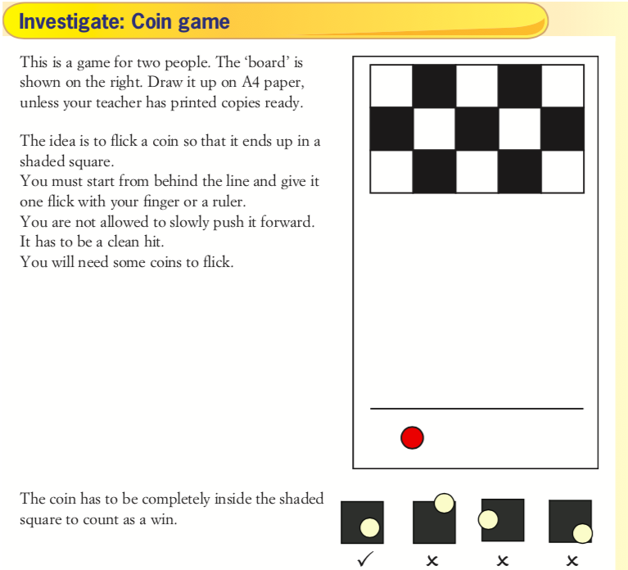
1) Before you start: Write down what you think about the likelihood of winning:
Is it unlikely, fifty-fifty, or likely?
Can you estimate the probability from 0 to 1?
2) Now play the game. Each player gets 10 goes. Write down how many wins you get.
You should both have a go with a 5-cent coin first
Then try a 10-cent coin
Do a 20-cent coin last
3) Post-game: Were your predictions right? Why/why not?
Which coin is easiest to win with? Why?
Are there any class-wide trends?

Slide 12
Class/Homework
Freefall Worksheet – The Language of Chance

Slide 13
Exit ticket
Write a summary answering the essential question.
Add at least five new terms to your glossary
Make sure these terms are added to the class’s Probability Poster (you will have a hard time making yours look as nice as the one made by Mr. Summers class)

